Slide 1
Semester Project: Automatic Video Summarization and Hashtag Generation
Snigdha Asthana- SE20UARI146

Slide 2
Problem Definition
The increasing volume of video data poses challenges for both creators and viewers. Long videos are time-consuming, making it hard to quickly grasp essential information. This project addresses key challenges in managing video content by aiming to solve:
1.How can we automatically summarize lengthy videos into concise, informative highlights without human intervention?
2.How can we generate relevant and trending hashtags that enhance the discoverability and engagement of video content on social media platforms?
Notes:
Manual editing and hashtag generation are not only labor-intensive but also subject to human error and inconsistency. The diversity of content, from educational lectures to social media posts, requires a versatile solution.

Slide 3
Proposed Solution
In today's digital age, video content is abundant, making efficient content processing crucial. Our project focuses on addressing this need by automating two essential tasks:
•Video Summarization: Extracting key moments(frames) from videos to provide a quick overview.
•Hashtag Generation: Generating relevant hashtags to improve content visibility and engagement.

Slide 4
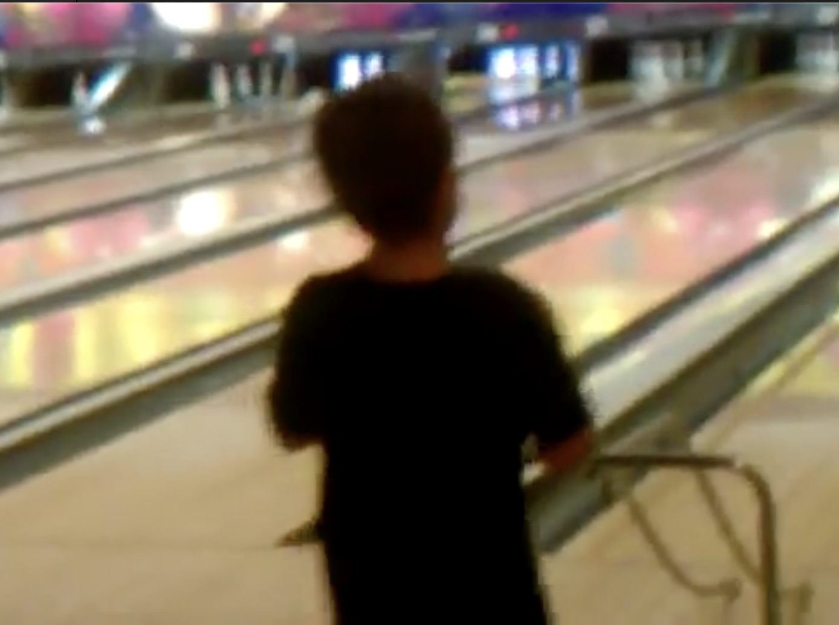
Steps in the Project
Spatiotemporal Video Captioning
Video Preprocessing
Frame Extraction
Resizing and Normalization
Visual Encoder - TimeSformer
Text Decoder - GPT2
Caption Generation
Generated Caption: A young boy throws a bowling ball down a bowling lane.
3
1
1
Label- Bowling
['#bowling', '#youngboy', '#bowlingball', '#bowlinglane', '#throwing', '#sports', '#fun', '#games', '#kids', '#sportsfun', '#youth']
2
2
4
Hashtag Generation
Feature Extraction And Video Summarization
LlaMA-2 LLM
Motion Features
Color Analysis
Object Detection
Event Detection

Slide 5
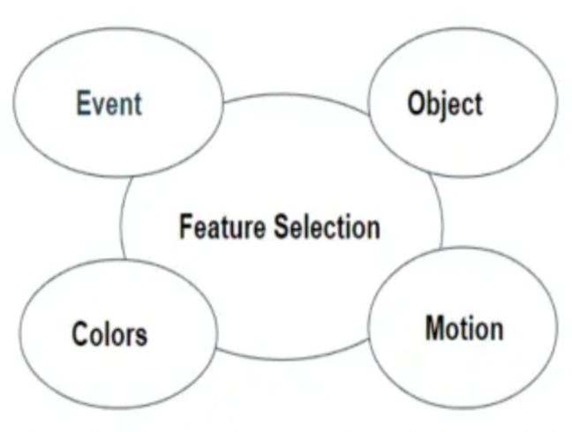
Video Summarization- An Unsupervised Machine Learning Approach
Motion Features
-Optical Flow Calculation
-Motion Detection
-Clustering(K-means)
Color analysis
-Color Histogram Computation
-Clustering(K-means)
-Enhances visual appeal
Notes:
Motion features- It calculates optical flow between each pair of consecutive frames using the Farneback method(OpenCV).
Optical flow represents the apparent motion of objects between frames.The mean magnitude of optical flow vectors for each frame pair is computed and stored as a motion feature. Then KMeans clustering is applied to group similar motion features into 'k' clusters.
In Colour analysis, color histogram is calculated for the input frames using OpenCV - The histogram represents the distribution of colors in the frame, divided into 8 bins for each channel (RGB).
KMeans clustering to group similar color distributions into 'k' clusters.Keyframes which are selected are frames that best represent the different color themes observed in the video.

Slide 6
Video Summarization- An Unsupervised Machine Learning Approach
Event Features
-Identifies significant actions or transitions.
-Analyzes audio and visual cues.
Object Detection
-Recognizes relevant objects.
-Tracks objects of interest.
Notes:
Event detection- Detects significant events in the video by identifying segments where the motion feature exceeds a specified threshold.
Object detection- recognition of relevant objects within the video using object detection models like YOLOv4 to identify and track objects of interest.

Slide 7
Why Unsupervised Machine learning approach?
One major challenge is the lack of a large-scale annotated dataset that can facilitate supervised learning.
1. No Labels Required
2. Scalable
3. Flexible
4. Automated Processing
Notes:
1.Unsupervised methods don't need annotated data, saving time and cost. 2.Handles large datasets without labeled examples, suitable for various video types.
3.Adapts to diverse video content without specific labels, accommodating different lengths, genres, and content types. 4.Fully automated for efficient summarization of large video collections, minimizing human effort.

Slide 8
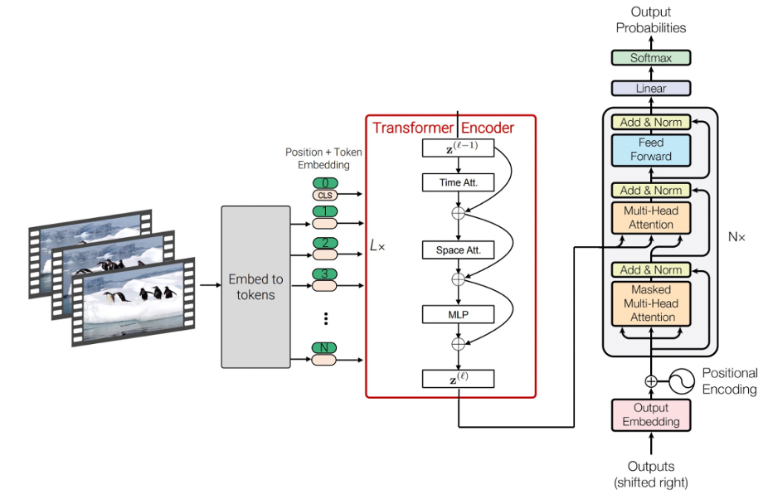
SpaceTimeGPT
Spatiotemporal Video Captioning
Dataset- Vatex dataset
41,250 videos and 825,000 captions.
covers a wide range of human activities, encompassing over 600 in total.
Vison Endcoder model: TimeSformer
Text Decoder model: GPT-2
Notes:
The model architecture depicted in the image illustrates a Spatiotemporal Video Captioning Model that leverages.
The videos in VATEX cover a wide range of human activities, encompassing over 600 in total.

Slide 9
SpaceTimeGPT
Vision Encoder: TimeSformer
Text Decoder: GPT-2
Input frames
Output Embedding
Linear Embeddings
Positional Encoding
Multi-Head Attention
Position + Token Embeddings
Time attention
Transformer Decoder
Space attention
Feed Forward
Transformer Encoder
Output- caption
Eg- A lady is sitting on a chair and eating a sandwich.
MLP
Notes:
Vision Encoder: TimeSformer- The TimeSformer (Time-Space Transformer) is a model designed to process video data using a transformer architecture.
1. Input Frames: Takes a sequence of video frames.
2. Embed to Tokens: Frames are divided into patches and embedded into tokens, capturing local features.
3. Position + Token Embedding: Adds positional encodings to retain the order of patches and frames.
4. Transformer Encoder: Processes tokens with temporal and spatial self-attention, followed by an MLP:
- Time Attention: Captures relationships between patches across frames.
- Space Attention: Captures relationships between patches within the same frame.
- MLP: Processes attended features.
Text Decoder: GPT-2 is a generative model(LLM), meaning it can generate text based on the input provided to it.
1. Output Embedding: Uses features from the Transformer Encoder to initialize the GPT-2 decoder.
2. Positional Encoding: Adds positional encodings to output tokens to maintain order.
3. Transformer Decoder: Consists of multiple layers (N):
- Multi-Head Attention: Incorporates features from the Transformer Encoder.
- Feed Forward: Processes attended features.
- Add & Norm: Includes residual connections and layer normalization to enhance learning.

Slide 10
Key Characteristics
1.Convolution-free
2.Transformer-based
3.Patch-based Processing
4.Self-Attention
Notes:
1.The TimeSformer architecture eliminates the use of convolutions, relying solely on self-attention mechanisms to capture spatial and temporal relationships. 2.: The model adapts the Transformer architecture, widely used in NLP, for video processing.
3.: By dividing video frames into small patches, the model efficiently captures local features and relationships within and across frames.
4.: The use of self-attention mechanisms allows the model to learn complex relationships in both spatial and temporal dimensions.

Slide 11
Hashtag Generation
Hashtags are generated using Llama-2 LLM.
Input: "A young boy throws a bowling ball down a bowling lane."
Output: ['#bowling', '#youngboy', '#bowlingball', '#bowlinglane', '#throwing', '#sports', '#fun', '#games', '#kids', '#sportsfun', '#youth']
Notes:
LLaMA-2 is a multimodal model architecture designed for various natural language processing (NLP) tasks, including text generation, summarization, chat, and more.

Slide 12
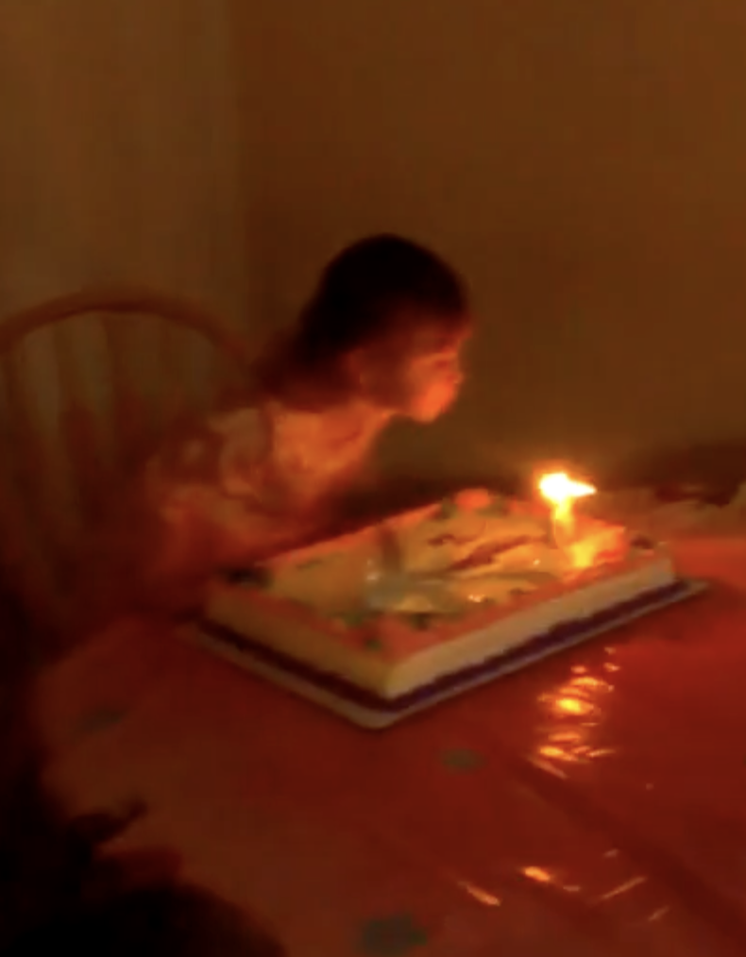
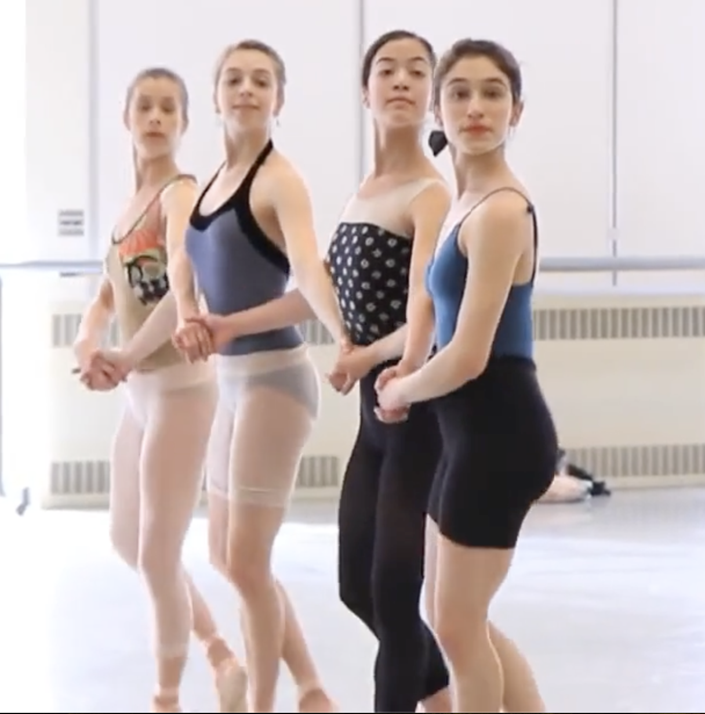
Results
Video Label caption Hashtags
 | Blowing out candle | A young girl blows out candles on a birthday cake. | ['#birthdaycake', '#birthdaygirl', '#candleblowing', '#birthdaywishes', '#kidbirthday', '#birthdayfun', '#birthdaycelebration', '#birthdaymemories', '#birthdaytraditions']
 | Dancing Ballet | A group of young women are practicing ballet in a dance studio. | ['#ballet', '#dance', '#youngwomen', '#practice', '#dancestudio', '#fitness', '#exercise', '#movement', '#performance', '#art']
Notes:
Kinetics-400 is a collection of large-scale, high-quality datasets of URL links of up to 650,000 video clips that cover 400 human action classes

Slide 13
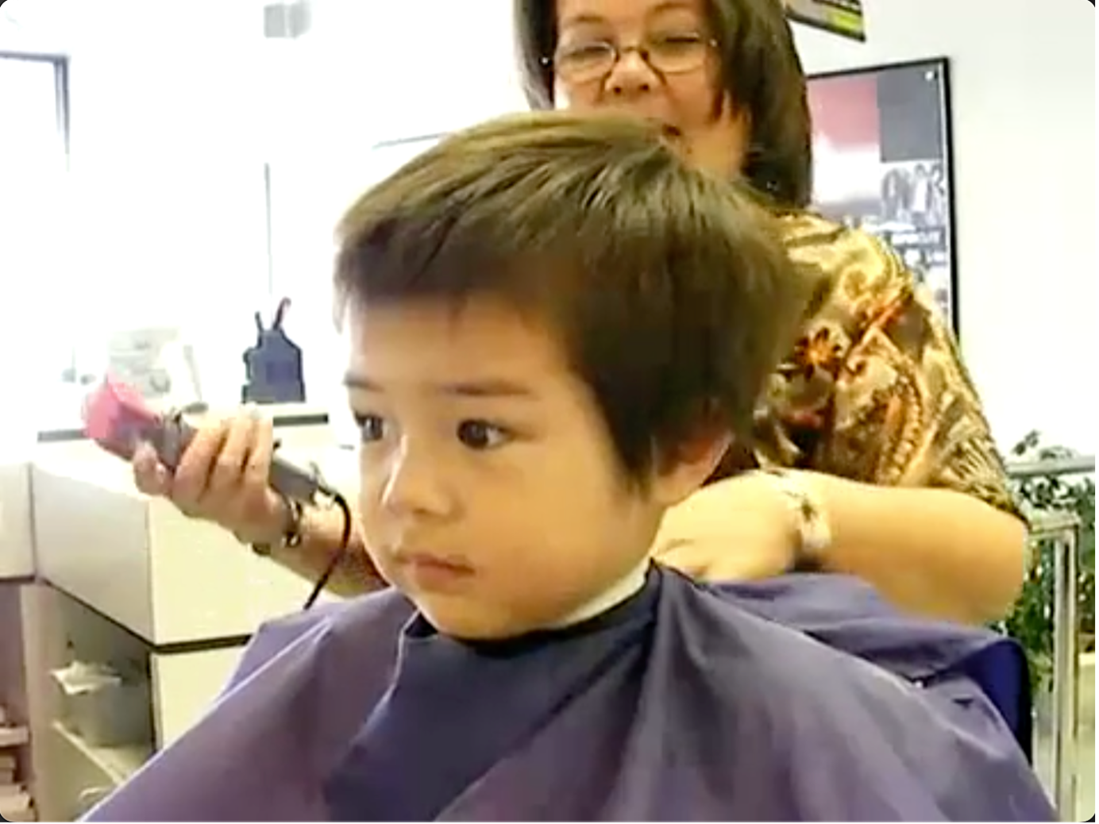
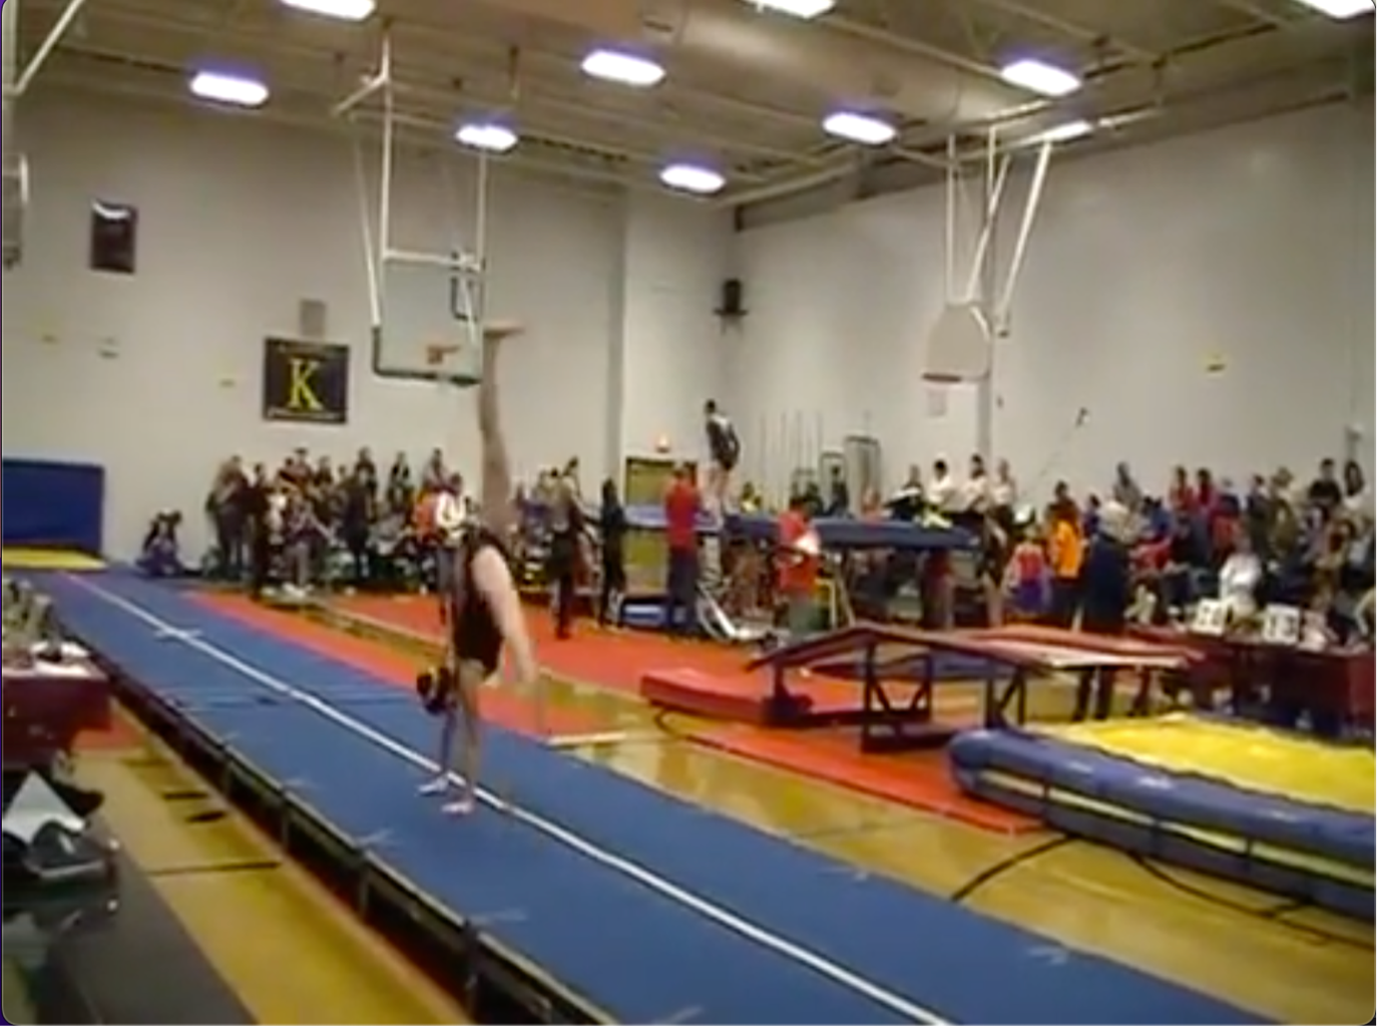
Results
Video Label caption Hashtags
 | Getting a haircut | A young boy is getting his hair cut at a salon | Generated Hashtags: ['#haircut', '#kid', '#salon', '#barber', '#fades', '#trims', '#style', '#youth', '#grooming', '#kids', '#cuttingedge', '#freshcut', '#littleman', '#hairgoals', '#sundayfunday', '#haircare', '#kidslife']
 | gymnastics tumbling | A gymnast does a back flip on a mat in a gymnasium | Generated Hashtags: ['#gymnastics', '#backflip', '#gym', '#tumbling', '#athlete', '#acrobatics', '#flip', '#tumbling', '#gymrat', '#gymlife', '#gymnasticslove']

Slide 14
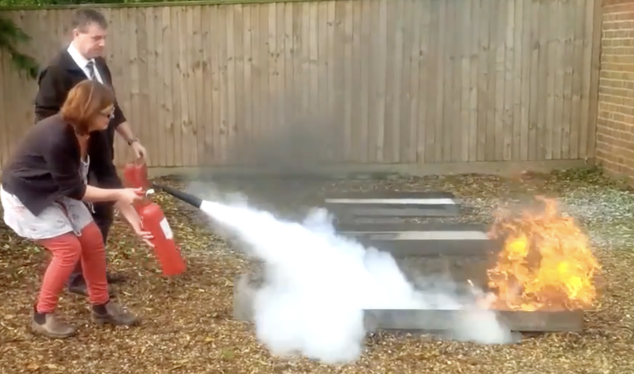

Results
Video Label caption Hashtags
 | Extinguishing fire | Generated Caption: A group of people are outside in the middle of a fire and are trying to extinguish it | Generated Hashtags: ['#firefighters', '#safetyfirst', '#teamwork', '#emergencyresponse', '#fireextinguisher', '#flames', '#rescue', '#heroes', '#fightingfire']
 | Brushing teeth | Generated Caption: A little boy is brushing his teeth with a toothbrush | Generated Hashtags: ['#brushyourteeth', '#goodhygiene', '#kidslife', '#oralhealth', '#toothbrush', '#toothcare', '#hygienehabits', '#smile', '#healthyliving', '#kidsmatter']

Slide 15
Uses of the Project
Social Media and Content Creation
- Instagram Reels
Automatically generate concise, engaging summaries of longer videos.
Automatic hashtag generation to improve discoverability with relevant and trending hashtags.
- YouTube
Create brief summaries for video descriptions to help viewers quickly understand the content.
Generated hashtags to enhance video discoverability on the platform.

Slide 16
Uses of the Project
News Agencies
Summarize lengthy news reports into brief clips for social media sharing.
Increase reach and engagement with appropriate hashtags.
Surveillance:
Use captions generated by the model for video surveillance.
Summarize surveillance footage for quick analysis and retrieval.

Slide 17
Thank You!
Q&A

